Slide 1
Asp.Net
Ch. 01
Server And Page
Notes:
BCA Sem-5 [ TYBCA ] Ch.1 Overview Of ASP.NET
MONARCH Education
By : Gohil Manoharsinh A.

Slide 2
Client – Server architecture :
Client/server architecture is a computing model in which the server hosts, delivers and manages most of the resources and services to be consumed by the client.
This type of architecture has one or more client computers connected to a central server over a network or internet connection.
This system shares computing resources.

Slide 3
Client – Server architecture :
Client/server architecture is also known as a networking computing model or client/server network because all the requests and services are delivered over a network.
Client/server architecture works when the client computer sends a resource or process request to the server over the network connection, which is then processed and delivered to the client.

Slide 4
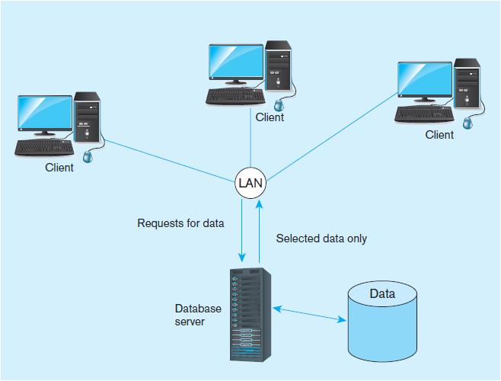
Client – Server architecture :

Slide 5
Application Web Servers…
(1) IIS Express:
IIS Express is the default web server for web application projects in Visual Studio 2012 and Visual Studio 2013, and it is recommended for both web application projects and web site projects.
(2) Local IIS :
Use IIS when you want to test your web application using the server environment that is closest to what the live site will run under, and it is practical for you to install and work with IIS on your development computer.

Slide 6
Application Web Servers…
You can use IIS with web application projects, but not with web site projects.
(3) External Host :
You can specify the URL of an external host that you will use for testing.

Slide 7
Application Web Servers…
(4) Custom Web Server :
Visual Studio 2013 adds support for specifying custom Web servers in your projects; this functionality enables developers to define the environment for testing their Web applications.

Slide 8
Internet Information Services (IIS)
Steps :
On the Start screen, right-click the Command Prompt tile, and then click Run as administrator.
At the command prompt, type the following: dism /online /enable-feature /featurename:netfx3
Wait for the command to complete. It could take several minutes.
Close the command prompt window.

Slide 9
Page architecture & Additing controls to page
What is a Layer?
A layer is a reusable portion of code that performs a specific function.
In the .NET environment, a layer is usually set up as a project that represents this specific function.
This specific layer is in charge of working with other layers to perform some specific goal.

Slide 10
Page architecture & Additing controls to page
  Data Layer
A DAL contains methods that helps the Business Layer to connect the data and perform required actions, whether to return data or to manipulate data (insert, update, delete and so on).
  Business Layer
Though a web site could talk to the data access layer directly, it usually goes through another layer called the Business Layer.

Slide 11
Page architecture & Additing controls to page
  Presentation Layer
The Presentation Layer contains pages like .aspx or Windows Forms forms where data is presented to the user or input is taken from the user.

Slide 12
The Page Class…
An ASP.NET page runs as a unit, combining the server-side elements in a page, such as controls, with the event-handling code you have written.
If you use a Web site project, you do not have to precompile pages into assemblies.
ASP.NET dynamically compiles pages and runs them the first time they are requested by a user.
If there are any changes to the page or resources the page depends on, the page is automatically recompiled.

Slide 13
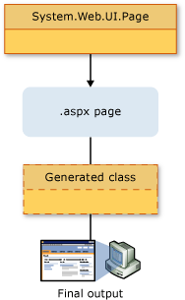
The Page Class…

